Slide 1

TestNG
Class 1

Slide 2
Agenda
What is TestNG ? Advantages of TestNG?
TestNG Annotations
Priority, Dependency, Enable/ Disable in TestNG

Slide 3
TestNG Introduction
TestNG is a testing tool, it is a unit test framework designed for testing needs, TestNG is designed to cover all categories of tests: unit, functional, integration, end-to-end etc.
It is inspired from JUnit and Nunit by adding new functionalities, which made TestNG more powerful than other unit test frameworks.
It is an open source automated testing framework; where NG of TestNG means Next Generation.
TestNG gives ability to write more flexible and powerful tests with help of easy annotations, grouping, sequencing & parametrizing.
TestNG provides a lot of advantage like parallel execution, Test Dependencies, Set Execution Order, Divide the tests in groups like smoke, sanity, regression and execute the group tests only.
The best feature of TestNG over Junit is TestNG report. TestNG generates the HTML report for Test Execution.

Slide 4
Benefits of TestNG
There are number of benefits but from Selenium perspective, major advantages of TestNG are :
It gives the ability to produce HTML Reports of execution
Annotations made testers life easy
Test cases can be Grouped & Prioritized (You can Set the Execution Order) more easily
Parallel testing is possible
Batch execution is possible
Assertions (verifications) is possible
Data Parameterization is possible
TestNG can be easily integrated with many different tools: selenium, maven, cucumber etc

Slide 5
What is annotation in TestNG ?
To execute TestNG script we don’t have to write the separate class. We can use simple java class but here we will not write public static void main(String []args) because we are not going to execute this from JVM.
TestNG works with Annotations and annotation can be represented by @ symbol
An annotation is a tag or meta-data that provides additional information about class, interface, or method in TestNG.
Annotations are used to keep the structure of the test classes.
Annotations invoke the methods according to the invocation time.

Slide 6
@Test Annotation in TestNG
The most important annotation of TestNG is Test annotation. This annotation marks a method or class as TestNG test.
@Test annotation makes a method to run as the base for the TestNG annotations, method annotated with @test will hold the test logic of the business and assertions.
Every @Test annotated methods should correspond to a manual test case, sometimes some teams may map every @test with a requirement.

Slide 7
Task
Task 1: Executing tests using @Test
Create three tests with unique @test methods names.
Execute all test methods

Slide 8
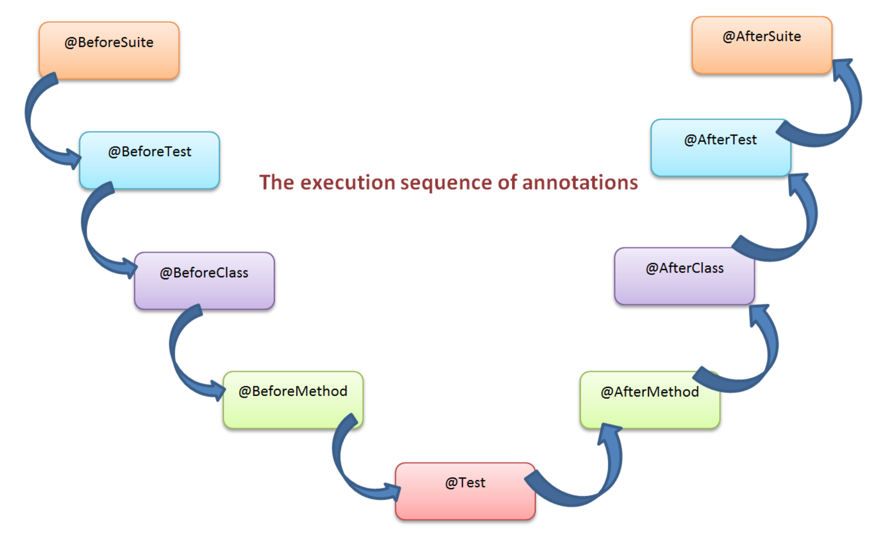
Annotations in TestNG
TestNG annotations execute in a predefined order. It's very easy to find out the execution sequence of TestNG annotations:

Slide 9
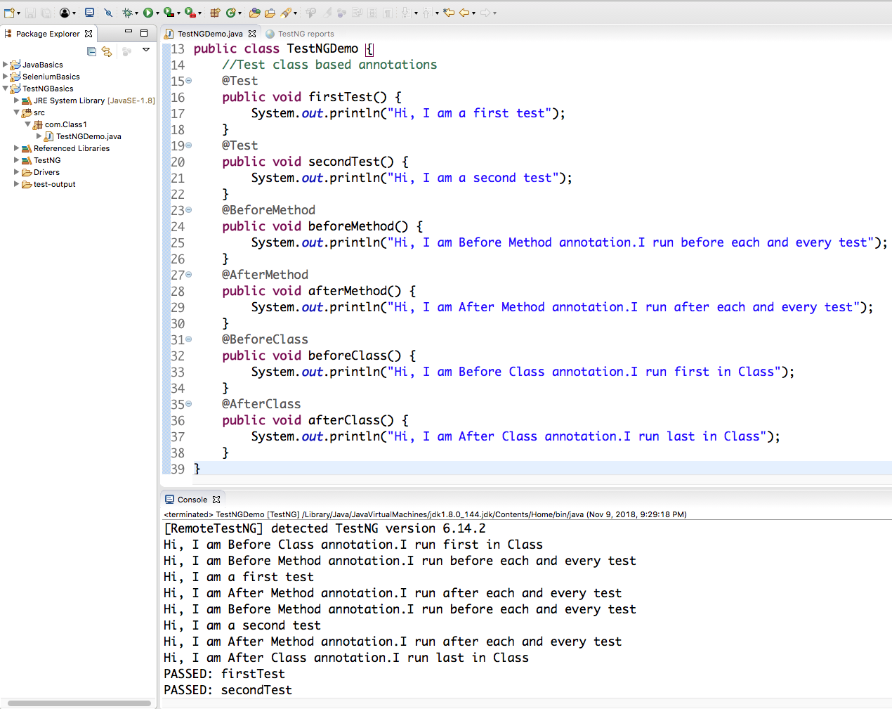
Execution order of TestNG Annotations

Slide 10
Test class based annotations
Annotation | Description
@BeforeClass | The annotated method will be executed Before any of the test method of a test class.
@AfterClass | The annotated method will be executed After any of the test method of a test class.
@BeforeGroups | The annotated method will be executed Before any of the test method belongs to specified group.
@AfterGroups | The annotated method will be executed After any of the test method belongs to specified group.
@BeforeMethod | The annotated method will be executed Before each test method @Test
@AfterMethod | The annotated method will be executed After each test method @Test
@Test | Marks a class or a method as a test method. If used at class level, all the public methods of a class will be considered as a test method.

Slide 11
Testng.xml based annotations
Annotation | Description
@BeforeSuite | The annotated method will be executed Before any tests declared inside the TestNG suite.
@AfterSuite | The annotated method will be executed After any tests declared inside the TestNG suite.
@BeforeTest | The annotated method will be executed Before test section declared inside the TestNG suite.
@AfterTest | The annotated method will be executed After test section declared inside the TestNG suite.

Slide 12
Task
Task 1: Executing different test based TestNG annotations
Create class that will have:
Before and After Class annotation
Before and After Method annotation
2 methods with Test annotation
Observe the results!

Slide 13
Writing test case using TestNG
Test case writing from TestNG include following steps:
Write the Business Logic of Test
Insert TestNG annotations in your Test
Add your Test information like - groups, classes, methods and modify it through testng.xml file.
Execute TestNG

Slide 14
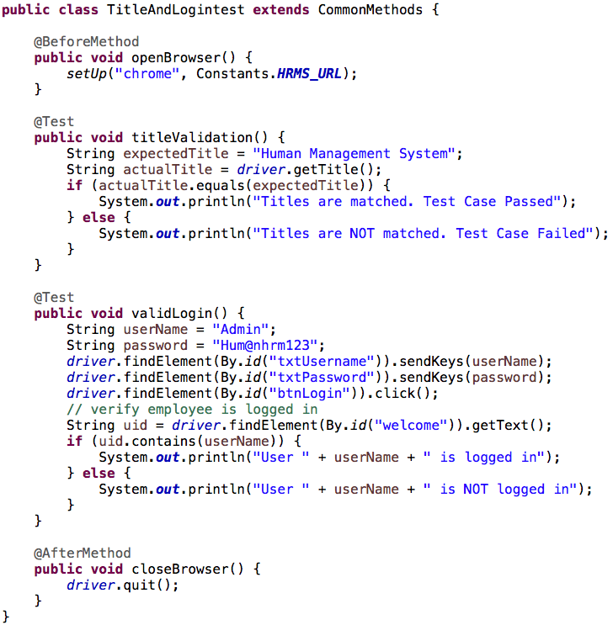
First TestNG-WebDriver Test Case

Slide 15
Test Case
TC 1: HRMS Application Login:
Open chrome browser
Go to http://hrmstest.syntaxtechs.net/humanresources/symfony/web/index.php/auth/login
Enter valid username and password
Click on login button
Then verify Syntax Logo is displayed
Close the browser
TC 2: HRMS Application Negative Login:
Open chrome browser
Go to http://hrmstest.syntaxtechs.net/humanresources/symfony/web/index.php/auth/login
Enter valid username
Leave password field empty
Verify error message with text “Password cannot be empty” is displayed.

Slide 16
TestNG Attributes
Attribute | Description
priority | The priority for this test method.
enabled | Sets whether the said method or the methods inside the said class should be enabled for execution or not. By default its value is true.
dependsOnMethods | Specifies the list of methods this method depends on.
groups | List of groups the said method or class belongs to.
description | The description of this method.
dataProvider | The name of the data provider, which will provide data for data-driven testing to this method.

Slide 17
Test Case Prioritization in TestNG
In TestNG, we can prioritize the Test Cases. Test case prioritization means, we can assign the priority to Test case.
Test case priority decides test case execution order. Higher prioritize test case execute first. So in TestNG “Priority” is used to schedule the test cases.
We can use this feature, When there are multiple test cases, we want to execute test cases in order.
We can declare the Priority at Method level as well as Class level. We use need to add annotation as @Test(priority= ).
The default value will be zero for priority.
If you don’t mention the priority, it will take all the test cases as “priority=0” and execute.

Slide 18
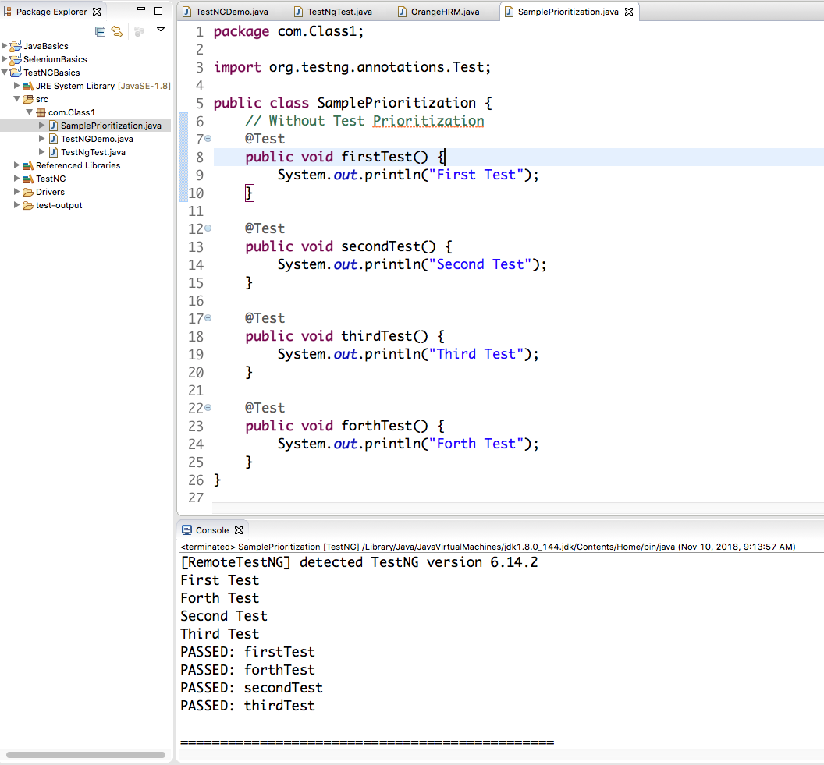
Test Case Prioritization in TestNG

Slide 19
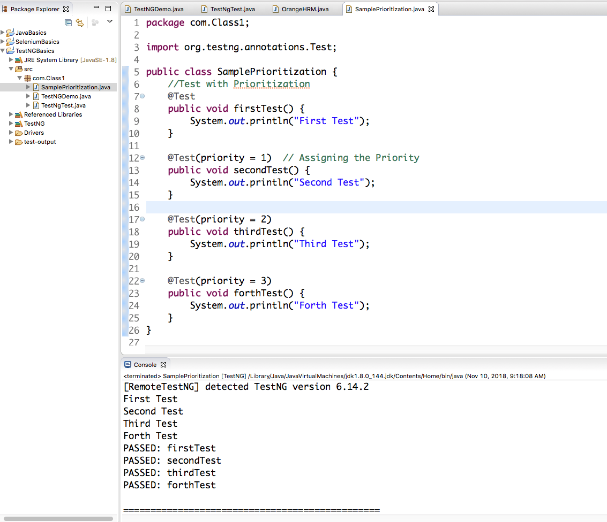
Test Case Prioritization in TestNG

Slide 20
Enable / Disable in TestNG
In some situations, we may need to avoid the execution of some of the tests or set of tests present in a specific test class.
For example, there might be situation where feature is already broken so we know it will fail and because of that you might want to ignore those test cases from the suite or from the test class.
When we denote any test method with the property of enabled with false value, then that method will not be part of test execution and TestNG will skip such methods.
By default, TestNG considers enabled=true, if you don't provide one

Slide 21
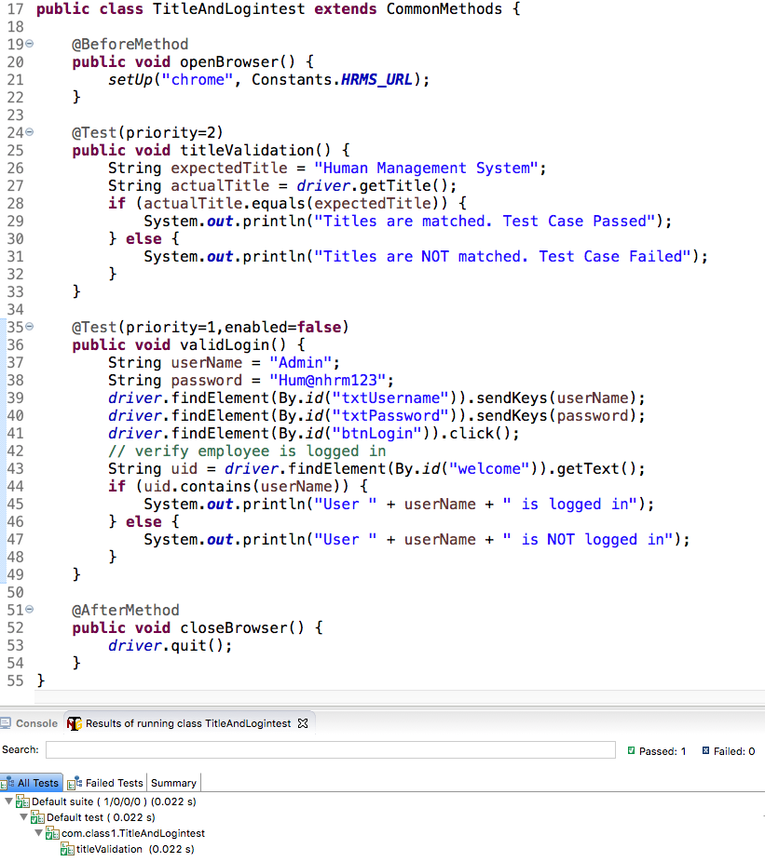
Enable / Disable in TestNG

Slide 22
TestNG
Class 2

Slide 23
Agenda
Assertion in TestNG
Hard Assertion vs Soft Assertion
TestNG XML file
TestNG Reports

Slide 24
Assertion in TestNG
The assertion in TestNG means “Trust but Verify” Assertion is performed to compare the Actual result with expected result. In TestNG assertion is performed with the help of Assert Class.
Assert helps us to verify the conditions of the test and decide whether the test has failed or passed. It is most popular and frequently used methods in TestNG while creating Selenium Scripts.
Suppose, In selenium, there will be the situation in the test where you need to check the presence of an element. All you need to do is to put an assert statement on to it to verify its existence.

Slide 25
What is Assertion and types of Assertion in TestNG
Asserts helps us to verify the conditions of the test and decide whether test has failed or passed. A test is considered successful ONLY if it is completed without throwing any exception.
There are two types of assertions present in the TestNG :
Assert class / Hard Assert
SoftAssert class / Verify

Slide 26
Methods of Assertion Class
Assert.assertEquals(actual, expected) assertion
This assertion is useful to compare expected and actual values If both values match then its fine and will continue execution. But if fails then immediately it will mark that specific test method as fail and exit from that test method.
Assert.assertNotEquals(actual, expected, message) assertion
It's function is opposite to assertEquals assertion. Means if both sides values will not match then this assertion will pass else it will fail. Here you can write your own message for failure condition. Simplest example of Assert.assertNotEquals in selenium webdriver
Assert.assertTrue(condition) Assertion
assertTrue assertion is generally used for Boolean condition true. It will pass if condition returns "true". If it will return false then it will fail and skip software test execution from that specific method.
Assert.assertFalse(condition) Assertion
It will check boolean value returned by condition and will pass if returned value is "False". If returned value is pass then this assertion will fail and skip execution from current test method.

Slide 27
Hard Assertion
Assert class is present in org.testng.Assert class in TestNG under Selenium webdriver, this assert also known as Hard assert.
In hard assertion tests immediately fail and stop executing while assertion fails.
Hard assert compares two items and results in pass or fail. But in-case if the assert is failed then the code after the assert statement will not be executed and because of this only we are calling it as Hard Assert.
All the method present in Assert class are static methods so we can access all the methods using class reference, so no need to create object
We may want to use a hard Assert to verify if we have logged in correctly and fail the test if we haven’t as there is no point in proceeding further if the test if the precondition itself fails.

Slide 28
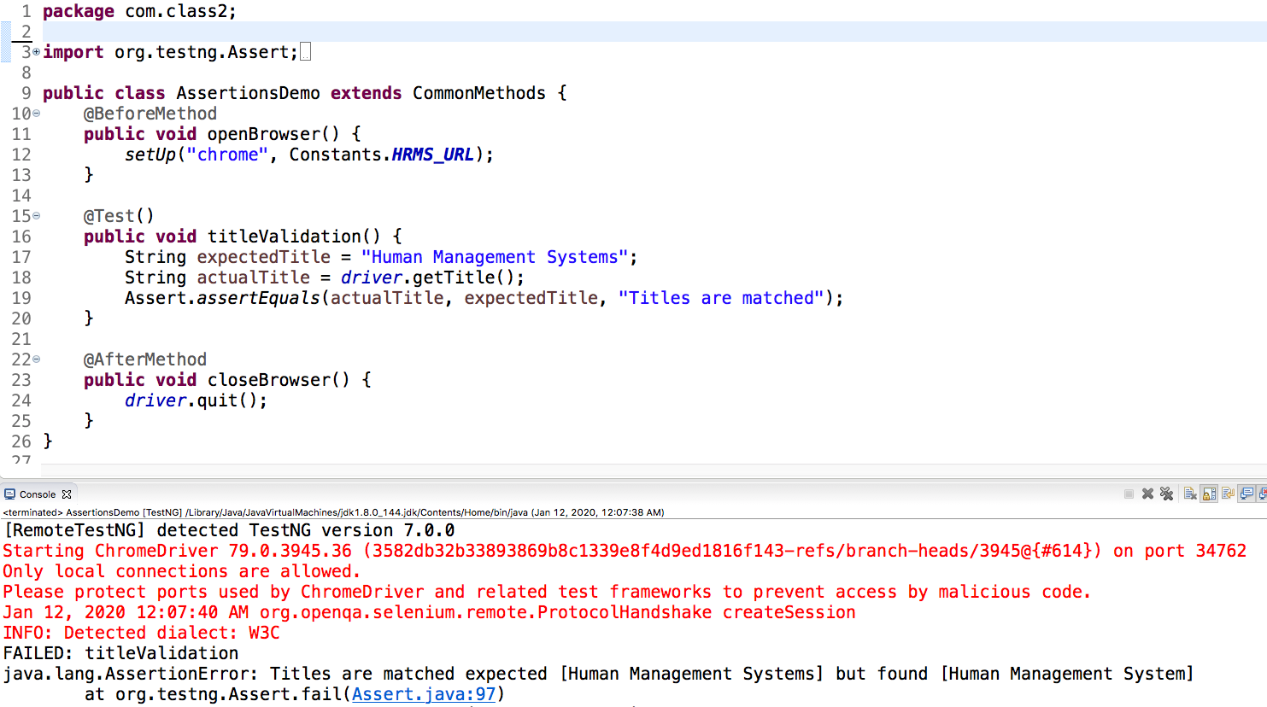
Hard Assertion

Slide 29
Soft Assert
SoftAssert in TestNG is a child of Assert , the SoftAssert not only asserts a given conditions, but also gives a chance to user to continue the execution after Assertion failure.
In soft assertion tests don’t stop running even if an assertion condition fails, but the test itself is marked as a failed.
This is useful if we are doing multiple validations in a form and you may actually want to complete all the validations and fail the test once all validations are complete in case of failures.
But in soft assertion you need to add assertAll() method in the last statement to mark the test failure otherwise it will not mark the test fail in Test report.
assertAll() method collates all the failures and decides whether to fail the test or not at the end. This should be the last statement in your test, the program will not execute after assertAll() if the assertion fails.

Slide 30
Soft Assert
Soft Assert – Soft Assert collects errors during @Test. Soft Assert does not throw an exception when an assert fails and would continue with the next step after the assert statement.
If there is any exception and you want to throw it then you need to use assertAll() method as a last statement in the @Test and test suite again continue with next @Test as it is.

Slide 31
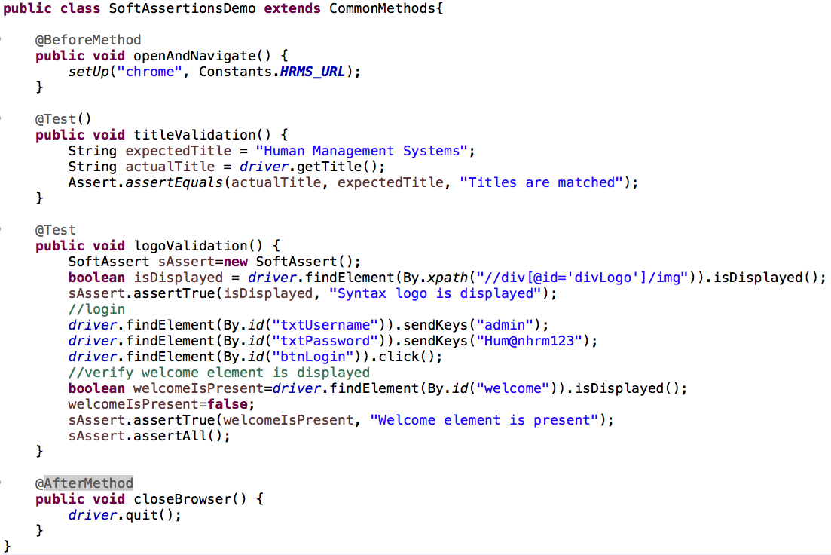
SoftAssert

Slide 32
Test Case
TC 1: HRMS Add Employee:
Open chrome browser
Go to “http://hrmstest.syntaxtechs.net/humanresources/symfony/web/index.php/auth/login”
Login into the application
Click on Add Employee
Verify labels: Full Name, Employee Id, Photograph are displayed
Provide Employee First and Last Name
Add a picture to the profile
Verify Employee has been added successfully
Close the browser

Slide 33
Test Dependency in TestNG
Sometime we need to run test methods in certain order, as we need to run a test method that always runs after some other test method.
This kind of dependency is supported by TestNG and can be implemented using:
dependsOnMethods in @Testannotations.

Slide 34
Test Dependency in TestNG
public class DependencyTest { @Test public void start() { SOP("Starting the server"); } @Test(dependsOnMethods = "start") // Set dependency on start method public void init() { SOP("Initializing the data for processing!"); } @Test(dependsOnMethods = { "start", "init" }) // Set Dependencies on start and init tests public void process() { SOP("Processing the data!"); } @Test(dependsOnMethods = "process") public void stop() { SOP("Stopping the server"); }

Slide 35
testng.xml
Now supposing we have two/multiple classes to test software web application how will we run them?
To run multiple classes together we can run with help of tesng.xml file.
testng.xml is an XML file that describes configuration of TestNG test suite. Using Testng.xml file we can run test available in one or more class file
testng.xml file is a configuration file in TestNG. It is used to define test suites and tests.
testng.xml file used to pass Parameters to the test methods.
testng.xml file provides different options to include packages, classes and independent test methods in our test suite.
testng.xml file allows us to configure multiple tests in a single test suite and run them in multi threaded environment.
Can we run test without using testng.xml file?
Yes but once our test become larger and requires configuration of multiple test at one place, the best option is testng.xml.

Slide 36
testng.xml
TestNG allows:
Create tests with packages
Create tests using classes
Create tests using test methods
Include/exclude a particular package, class, or test method
Use of regular expression while using the include/exclude feature
Store parameter values for passing to test methods at runtime
Configure multi threaded execution options

Slide 37
Test Suite in TestNG
Test Suite is something which is used to execute the test cases in a batch. We include many test cases in a single suite and run these test cases as the batch.
So running a set of test cases together is call executing a Test Suite.
In TestNG, we can create the test suite using testng.xml file.
This testng.xml file is very important factor in TestNG.
This file could be used for configuring your test run, set test dependency, include or exclude any test, method, class or package and set priority etc.
We will see, How we can create this file and use it to make our execution process easier .
you will end up to a place where you need to execute so many test cases on a run. Running a set of test cases together is call executing a Test Suite.
Those test cases can be dependent to each other or may have to be executed in a certain order. TestNg gives us the capability to manage our test execution.

Slide 38
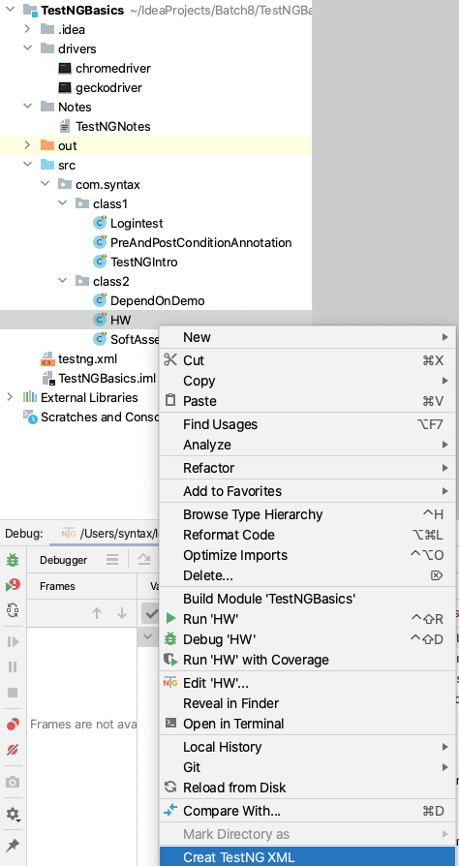
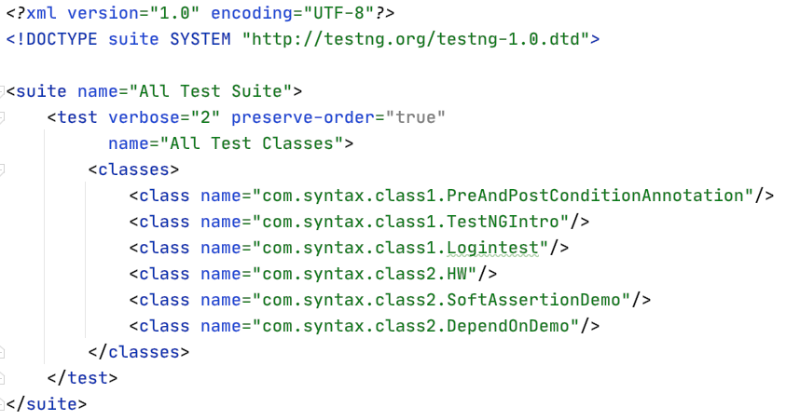
How to create and configure testng.xml file

Slide 39
How to create testng.xml file
<suite> : suite tag defines the TestNG suite. You can give any name to your suite using 'name' attribute. In above given example, We have given "Suite One" to our test suite.
<test> : test tag defines the TestNG test. You can give any name to your test using 'name' attribute. In above given example, We have given "Test One" to our test.
<classes> : classes tag defines multiple class. We can multiple test class under classes tag. In our example we have only one class.
<class> : class tag defines the class name which you wants to consider in test execution.

Slide 40
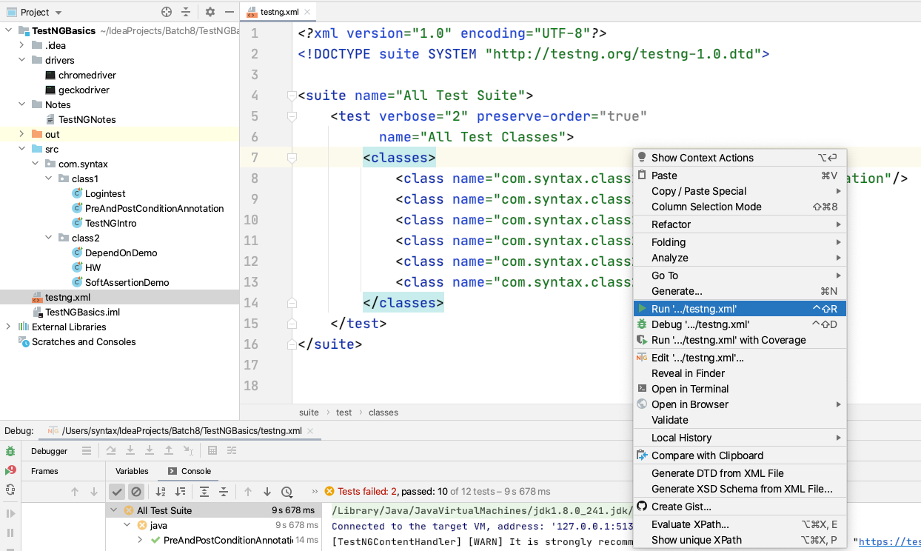
Executing testng.xml File

Slide 41
TestNG Report
Selenium Webdriver along with TestNG allows user to generate reports. Generating Report for test automation execution is essential part of the automation.
Execution reports play a crucial role in the formation of a sophisticated automation framework.
Reports helps you to identify the status of the test case (Pass/Fail/Skip).
Using reports we calculate time taken by each test case.
TestNG generates the HTML report which will be stored in "test-Output" folder in our project.
Every time we execute the TestNG test class or suite this report will refresh himself and display the latest result to you.
We can share automation reports with the team and clients as well to share the status of testing progress etc.

Slide 42
TestNG
Class 3

Slide 43
Agenda
Test Parameterization in TestNG
DataProvider in TestNG

Slide 44
alwaysRun
For before methods (beforeSuite, beforeTest, beforeTestClass and beforeTestMethod, but not beforeGroups) -->
If set to true, this configuration method will be run regardless of what groups it belongs to.
For after methods (afterSuite, afterClass, ...)-->
If set to true, this configuration method will be run even if one or more methods invoked previously failed or was skipped.

Slide 45
Test Case Grouping
In TestNG users can group multiple test methods into a named group. We can also execute a particular set of test methods belonging to a group or multiple groups.
This feature allows the test methods to be segregated into different sections or modules. For example, we can have a set of tests that belong to smoke test whereas others may belong to regression tests.
We can also segregate the tests based on the functionalities/features that the test method verifies. This helps in executing only a particular set of tests as and when required.

Slide 46
Test Case Grouping
‘Groups‘ is one more annotation of TestNG which can be used in the execution of multiple tests. which doesn’t exist in JUnit framework.
Using TestNG we can execute only set of groups while excluding another set. This gives us the maximum flexibility in divide tests and doesn't require us to recompile anything if you want to run two different sets of tests back to back.
Groups are specified in testng.xml file and can be used either under the or tag. Groups specified in the tag apply to all the tags underneath.
TestNG groups allow grouping of test methods. In TestNG, a test method can belong to more than one group and likewise, a group can consist of multiple test methods.
Groups are specified in your testng.xml file using the <groups> tag. It can be found either under the <test> or <suite> tag. Groups specified in the <suite> tag apply to all the <test> tags underneath.

Slide 47
Test Case Grouping
import org.testng.annotations.Test; public class TestGroupExample { @Test(groups = "smoke") public void testMethodOne() { SOP("Test method one belonging to smoke group"); } @Test public void testMethodTwo() { SOP("Test method two not belonging to group."); } @Test(groups = "regression") public void testMethodThree() { SOP("Test method three belonging to regression group"); } }
Note: If we will run above class normally, then test execution does not consider the group for execution and hence executes all the tests in the specified test class.

Slide 48
How to specify group through testng.xml
<suite name="Time test Suite" verbose="1"> <test name="Group Test"> <groups> <run> <include name="smoke" /> </run> </groups> <classes> <class name=“packageName.TestGroupExample" /> </classes> </test> </suite>
This method is the preferred and easy way to execute groups.

Slide 49
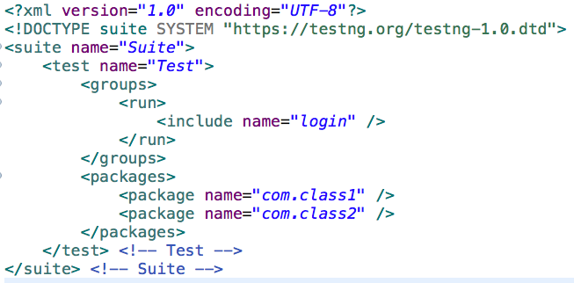
Including and excluding
TestNG also allows to include and exclude certain Groups, Test Methods, Classes and Packages from test execution. This helps in executing only a particular set of tests and excluding certain tests.
Example, when a feature is broken and you need to exclude a fixed set of tests from execution since these test will fail upon execution.
Once the feature is fixed you can then verify the feature by just executing the respective group of tests.
We can specify the include and exclude in testng.xml.
<include> – It tells which group we need to execute.
<exclude>- It tells which group we have to Skip

Slide 50
Test Parameterization in TestNG
Test case parameterization is the technique to execute the same Test Case with different input values. Parameterized tests allow us to run the same tests over and over again using different values.
It allows us automatically run a test case multiple times with different input and validation values.
Parameterization in TestNG can be done with the help of @DataProvider annotation
A Data Provider is a method annotated with @DataProvider that provides data for a test method.
@DataProvider Annotation of testng framework provides us a facility of storing and preparing data set in method. Means, you can configure data set in that method and then use that data in your test method.
@DataProvider annotated method must return an Object[][] with data.

Slide 51
Parameterized Test Using @DataProvider
Steps to parameterize the Test:
Create the data provider method with@DataProvider annotations. (Methods return type must be two-dimensional object arrays)
Declare the “Data Provider” name after the @Test annotation. Like – @Test (dataProvider = “data provider method name”)
Pass the arguments in the Test method, what you want to use from the data provider.

Slide 52
Interesting facts about the DataProvider
This annotation has one string attribute which is its name. If we don’t specify a name, then the method’s name serves as the default name.
A data provider method prepares and returns a 2D array of objects.
A data-driven test would run once for each set of data specified by the data provider object.
Number of values passed by a DataProvider method should be equal to number of attributes of test method on which DataProvider method is used. If DataProvider methods provided three parameter values, test method must accept three parameter and vise versa. Sequence is must.
We can execute a test method for multiple set of data using DataProvider which is not possible though Parameters annotation where we pass values from testng.xml.

Slide 53
Test Case
TC 1: HRMS Add Employee:
Open chrome browser
Go to HRMS
Login into the application
Add 5 different Employees and create login credentials by providing:
First Name
Last Name
Username
Password
Verify Employee has been added successfully and take screenshot (you must have 5 different screenshots)
Close the browser
Specify group for this test case, add it into specific suite and execute from xml file.

Slide 54
TestNG
Class 4

Slide 55
Agenda
Listeners in TestNG

Slide 56
Listeners in TestNG
Listener is defined as an interface that modifies the default TestNG behavior. Listeners implement the interface “org.testng.ITestListener”.
Listeners "listen" to the event defined in the selenium script and behave accordingly.
It is used in selenium by implementing Listeners Interface.
It allows customizing TestNG reports or logs. There are many types of TestNG listeners available.
Listeners provide us the flexibility to change and modify the TestNG default behavior.
TestNG manages everything through Suite, Test and Methods and the Listeners gives us the ability to act before and after of every Suite, Test and Methods.

Slide 57
Types of Listeners in TestNG
IAnnotationTransformer
IAnnotationTransformer2
IConfigurable
IConfigurationListener
IExecutionListener
IHookable
IInvokedMethodListener
IInvokedMethodListener2
IMethodInterceptor
IReporter
ISuiteListener
ITestListener
Note: all this listeners interfaces provided by TestNG extend ITestNGListener interface.

Slide 58
Methods of ITestListener
onStart() – This Invoked after the Test Class is instantiated but before any test method is called.
onFinish() – This invoked after all methods done and before the class finishes execution.
onTestStart() – Invoked each time before a test will be invoked.
onTestFailure() – Invoked each time a test fails.
onTestSkipped() – Invoked each time a test is skipped.
onTestSuccess() – Invoked each time a test succeeds.

Slide 59
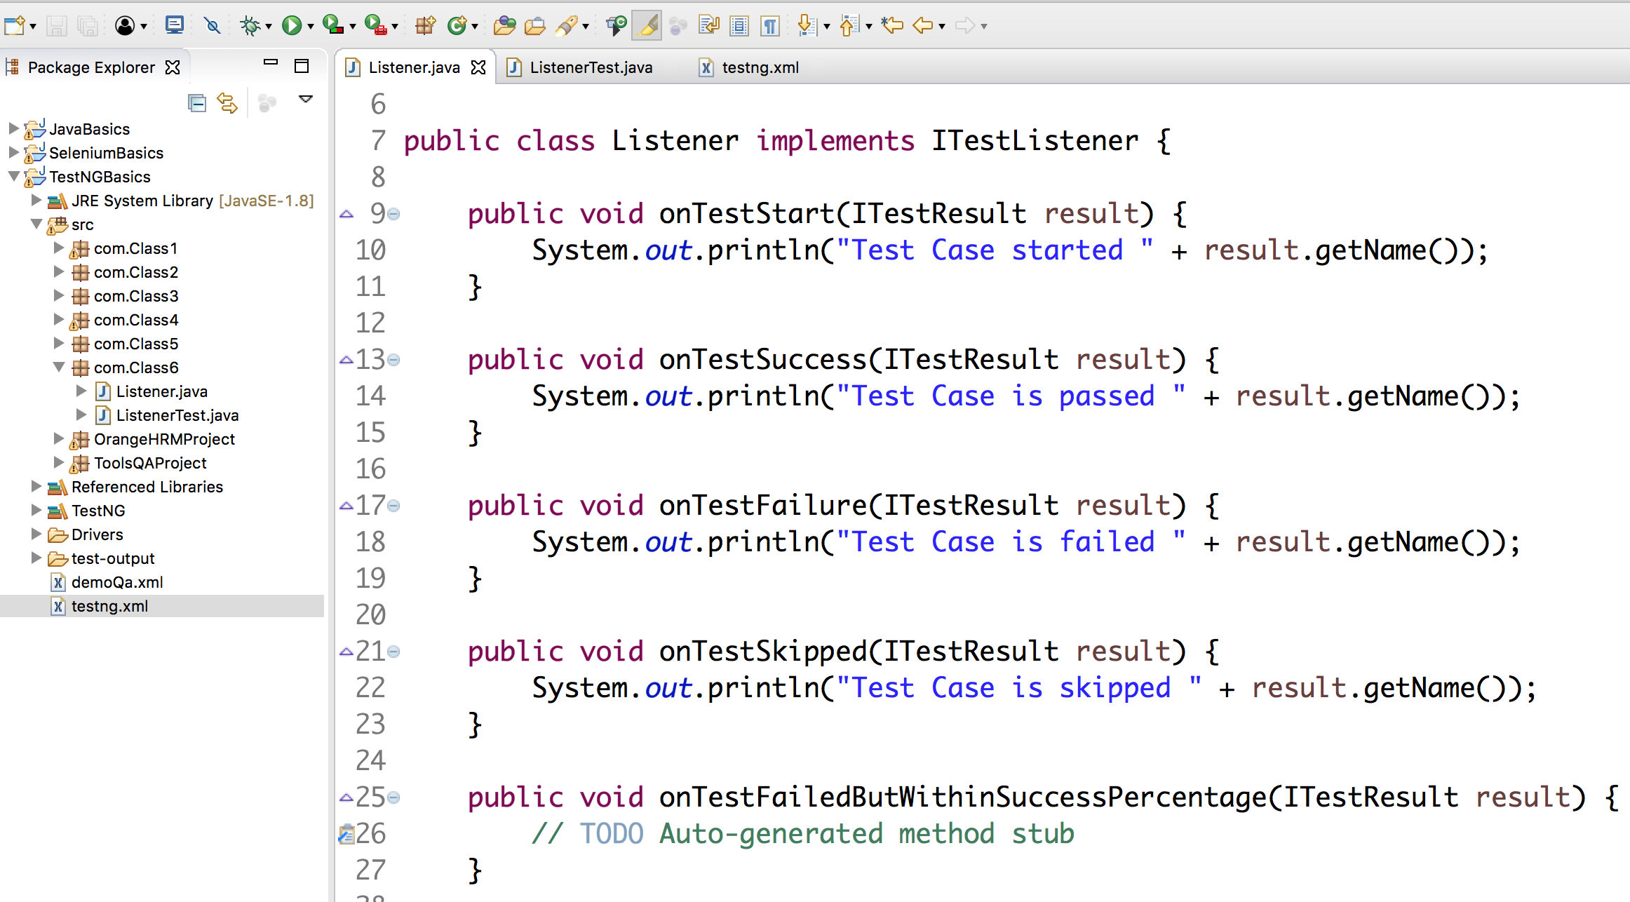
Implementation

Slide 60
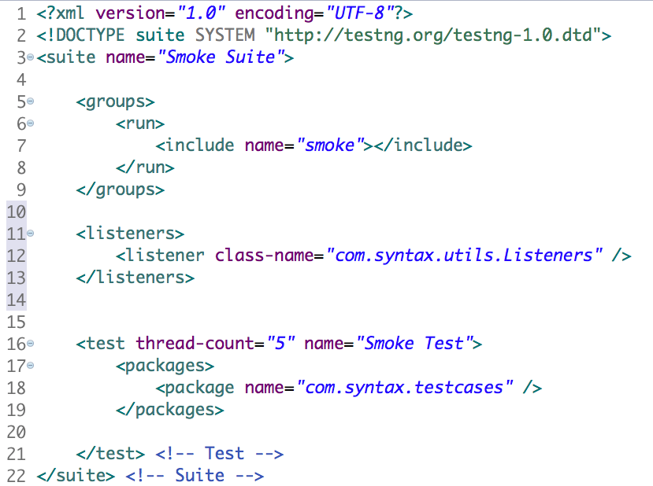
Implementation

Slide 61
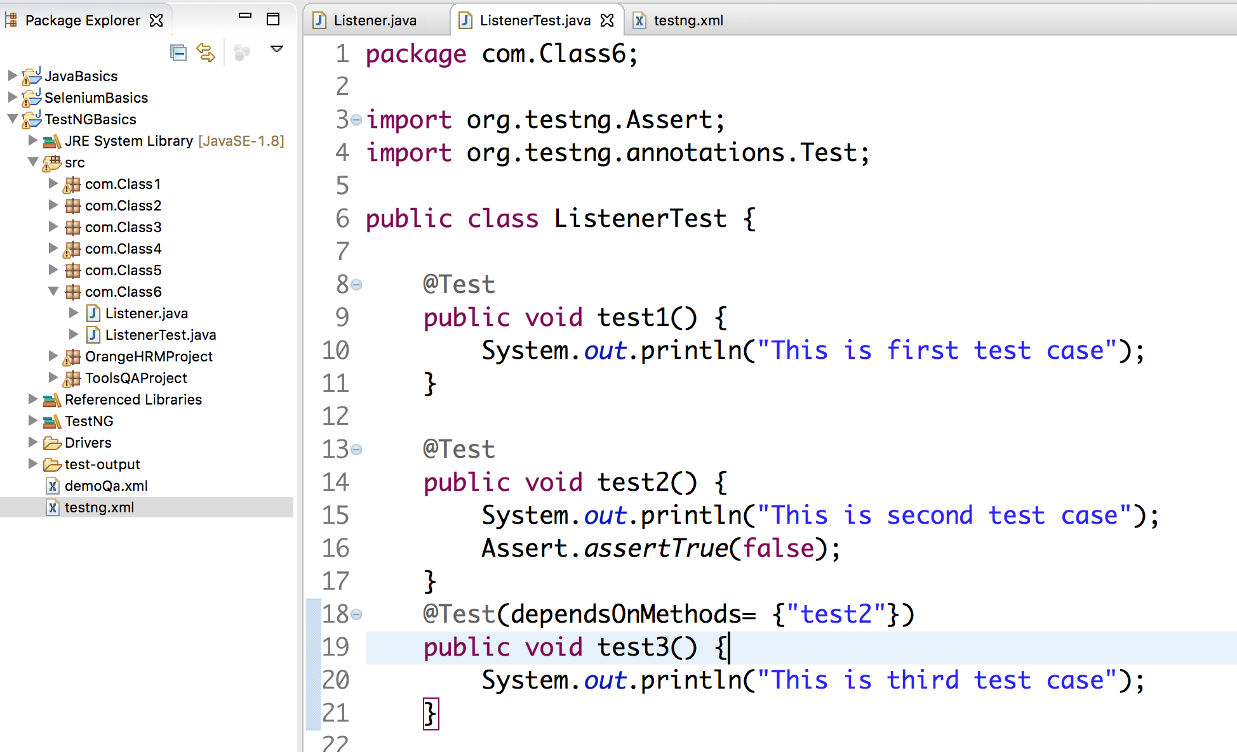
Implementation

Slide 62
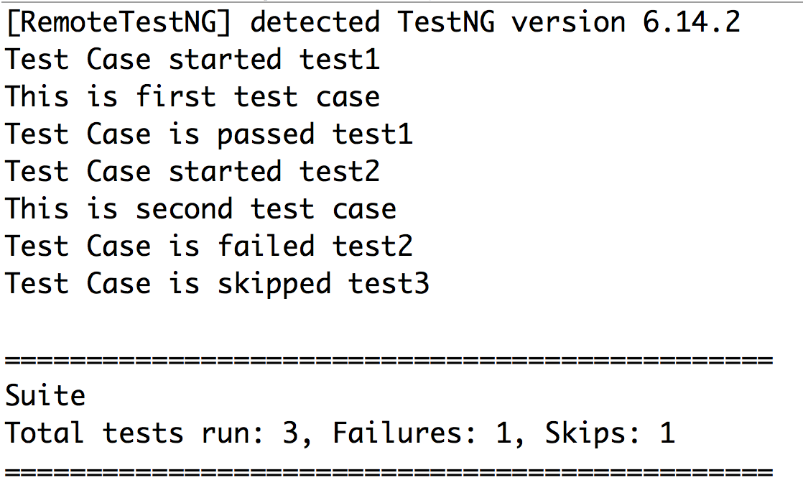
Implementation

